Slide 1
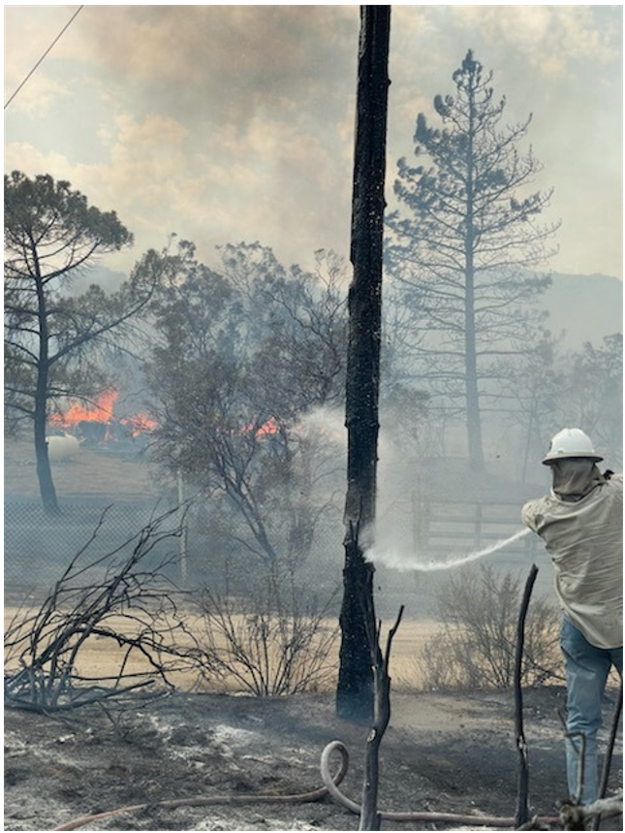
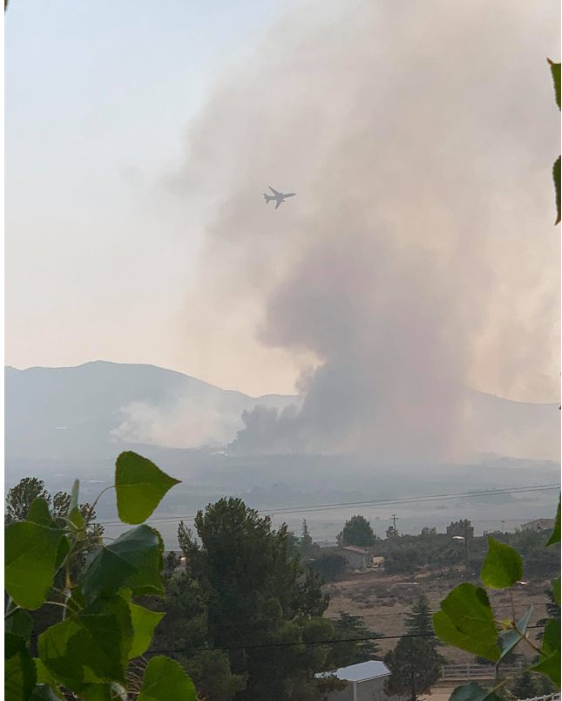
Wildfire Mitigation Plan Meeting 2022

Slide 2
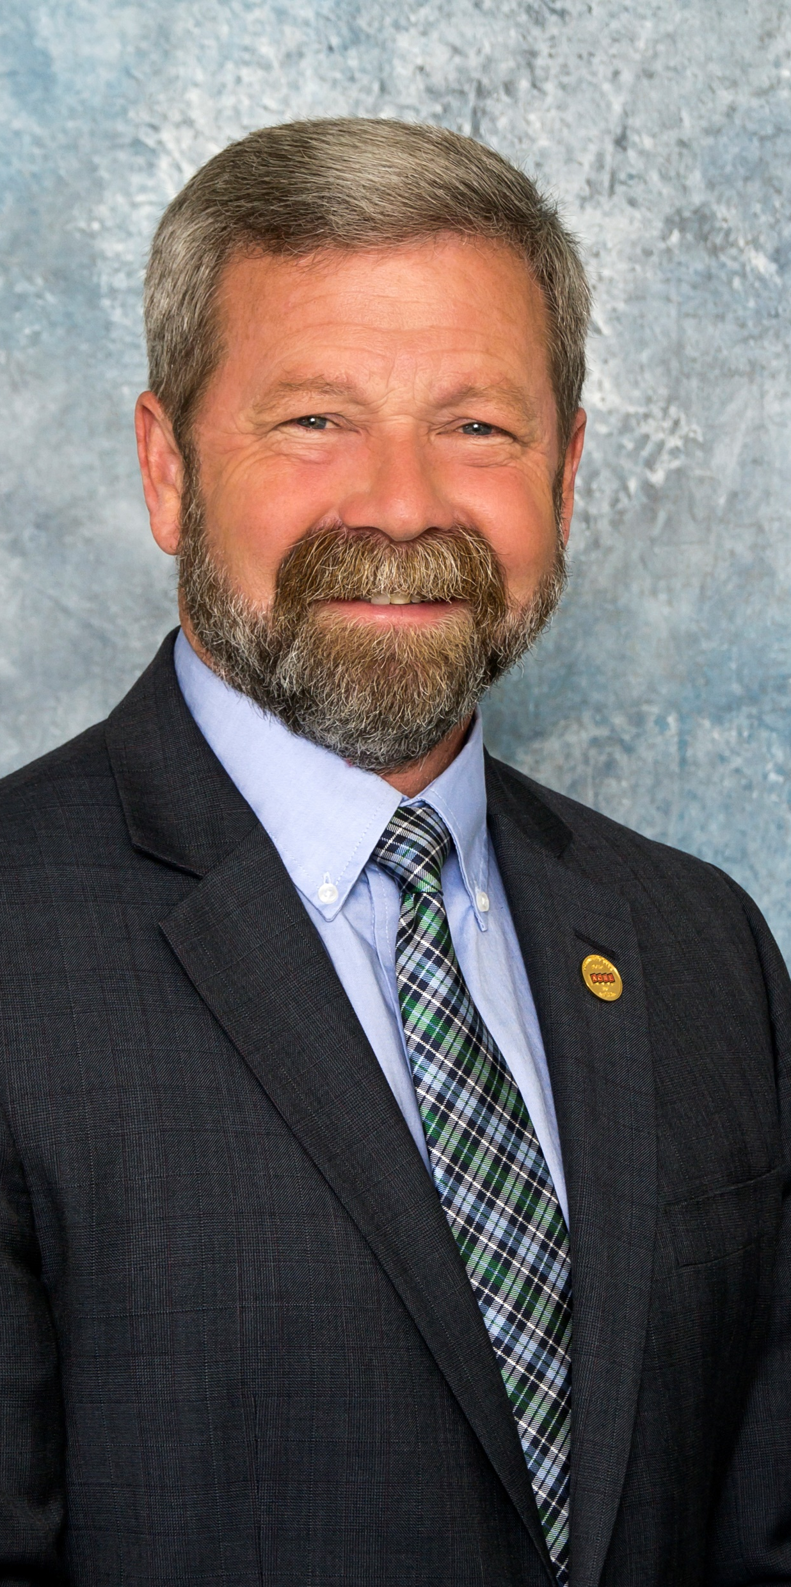
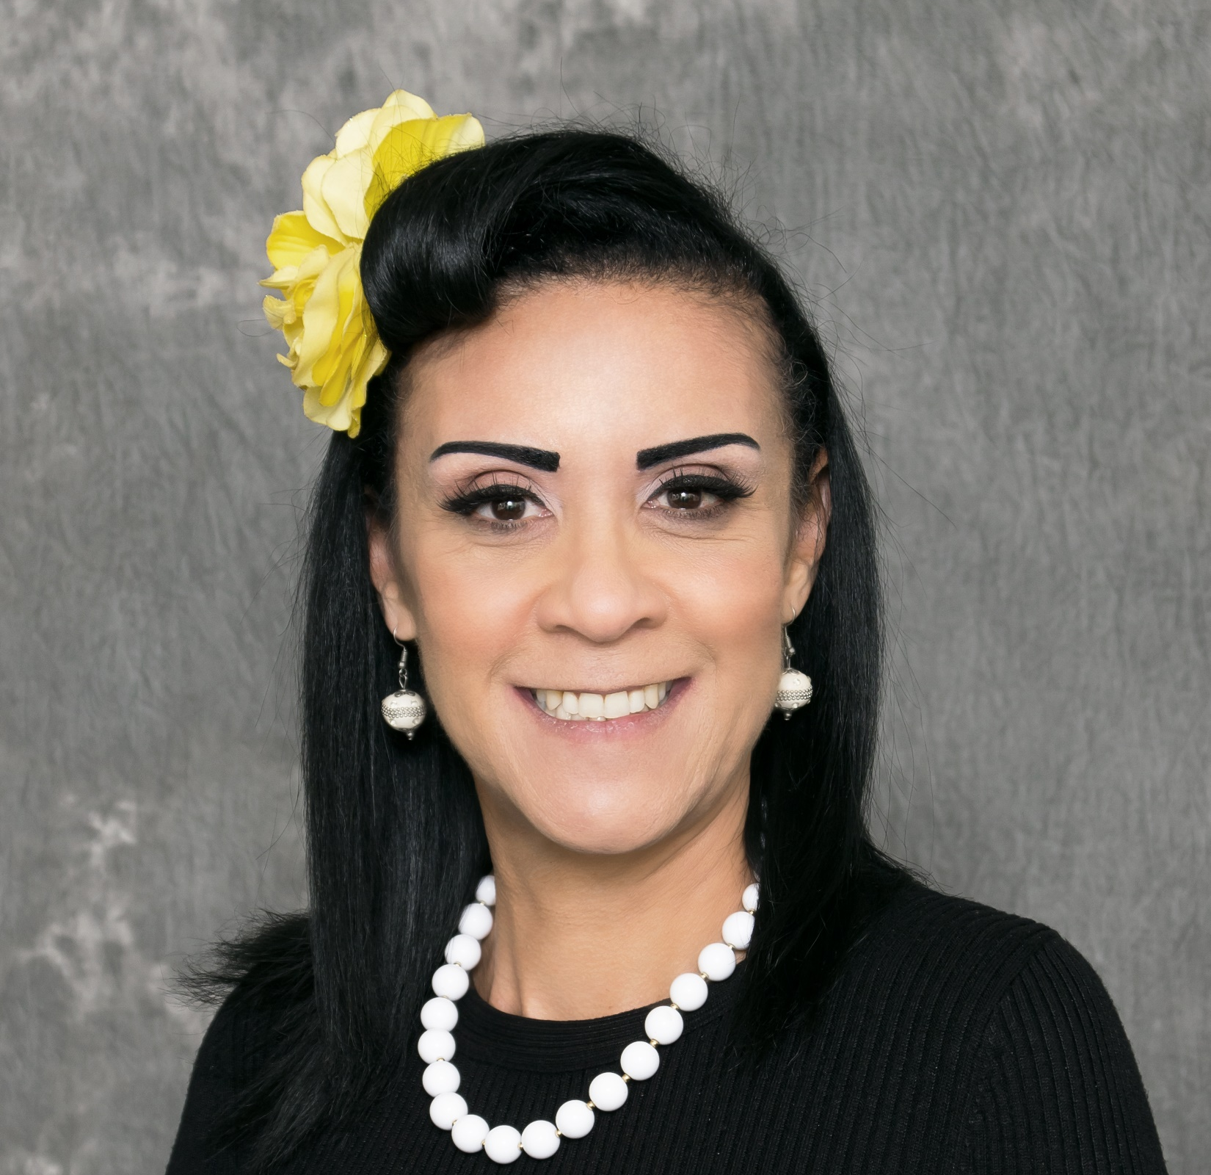
Introductions
General Manager, Kevin Short
Operations Manager, Brian Baharie
Government Relations Liaison, Jennifer Williams

Slide 3
Policy Statement
Anza Electric Cooperative, Inc. (AEC) exists to provide safe, affordable, and reliable utility service. AEC takes the safety of staff and the membership seriously. The cooperative has developed this Wildfire Mitigation Plan in compliance with State law, to identify potential risks within our system, prevention methods, and to ensure the safety of staff and our membership.

Slide 4
Purpose of the Wildfire Mitigation Plan
AEC developed this Wildfire Mitigation Plan meeting the requirements of the California Public Utilities Code, Chapter 6, §8387. (a), which requires each local publicly owned electric utility and electrical cooperative to develop a Wildfire Mitigation Plan. AEC’s Wildfire Mitigation Plan provides a comprehensive overview of the organizational and operational activities AEC undertakes in addressing the risk of fire within the Cooperative’s service territory
Notes:
Following several years of drought conditions and strong Santa Ana wind events, the risk of wildfire caused by utility assets has increased significantly.
As evidenced in this Wildfire Mitigation Plan, AEC has a company-wide focus on addressing and minimizing wildfire related risks to the health, safety and welfare of our membership. AEC is committed to fire prevention, safety, mitigation, control, and recovery and has taken a leadership role in addressing the threat of fire ignited with utility assets and facilities within our service territory. To enhance the capabilities of our membership and local communities defense against a wildfire event, AEC will share our personnel, resources, and information to effectively communicate all relative material.

Slide 5
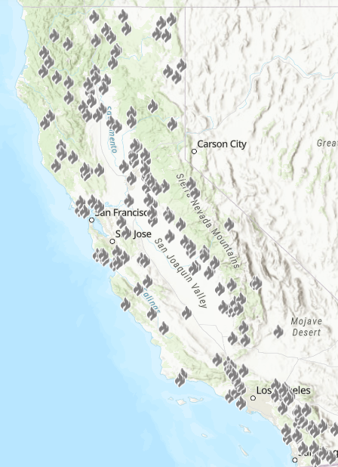
CAL FIRE 2021 Statistics:
Fire Incidents
8,835
Acres
2,568,948
Fatalities
3
Structures Damaged or Destroyed
3,629
2021 Known Fires in AEC’s Territory = 52

Slide 6
ORGANIZATION OF AEC’s WILDFIRE MITIGATION PLAN
This Wildfire Mitigation Plan includes the following elements:
Objectives of the plan;
Roles and responsibilities for carrying out the plan;
Identification of key wildfire risks and risk drivers;
Description of Wildfire Prevention Strategies;
Community outreach and public awareness;
Restoration of Service;
Metrics for measuring the performance of the plan and identifying areas for improvement;
Independent evaluation

Slide 7
Objectives of AEC’s Wildfire Mitigation Plan
Minimizing Sources of Ignition
Resiliency of The Electric Grid
Minimizing Unnecessary or Ineffective Actions
Notes:
Minimizing sources of ignition :The AEC Wildfire Mitigation Plan is founded upon the goal of minimizing the probability that the various components of our distribution systems might become the original or contributing source of ignition for a fire. AEC gathers and analyzes data from the National Weather Service and weather stations (provided by Davis Instruments, supplied by Western Weather) throughout our system to determine where and when the threat of a wildfire will present itself, which in turn facilitates the immediate organization and implementation of AEC’s response appropriate to the threat. Additionally, AEC continues to evaluate prudent, cost-effective changes and improvements to its physical assets that could and should be made to meet this objective and is implementing preventative operations, construction and maintenance plans consistent with these evaluations.
Resiliency is on the next slide
Minimizing unnecessary or ineffective actions: The final goal for this Wildfire Mitigation Plan is to measure the effectiveness of specific wildfire mitigation strategies. Where a particular action, program, or protocol is determined to be unnecessary or ineffective, AEC will assess whether a modification or replacement is merited. This plan will also help determine if more cost-effective measures would produce the same or better results.

Slide 8
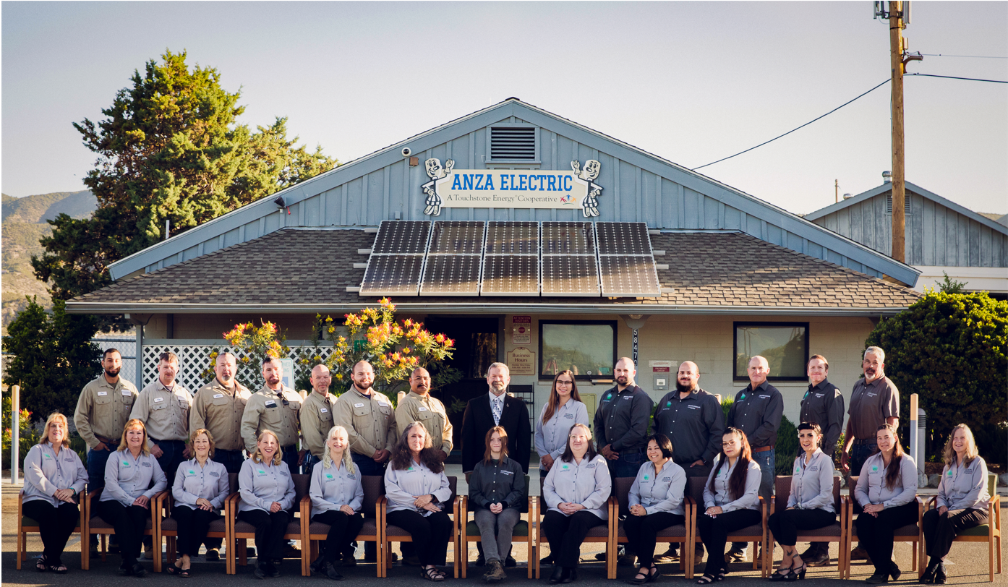
Roles and Responsibilities
AEC’s Board of Directors
General Manager
Operations Manager
Government Relations Liaison
Office Services Manager
Member Services Manager
Telecommunications Manager
ALL COOPERATIVE STAFF
Notes:
AEC’s Wildfire Mitigation Plan is subject to the direct supervision of the General Manager and delegated to senior management as follows:
Operations Manager is responsible for the evaluation of the High Fire Threat District boundaries, inspections of overhead distribution facilities and remediation of deficiencies in the HFTD, quality oversight and control, system hardening, vegetation management, developing protocols for Public Safety Power Shut-offs, and researching alternative technologies.
Government Relations Liaison is responsible for providing notification of Public Safety Power Shut-offs and the protentional for an event to the appropriate government agencies, including the Riverside County Emergency Management Department (EMD), all local, state and federal elected representative’s offices and local tribes, and emergency preparedness education and engagement with AEC members in coordination with EMD and other appropriate resources.
Office Services Manager is responsible for complete and accurate accounting practices for all Cooperative operation including financial risk analysis pertaining to wildfire mitigation efforts, including purchasing of equipment and setting budgets.
Member Services Manager is responsible for providing communications to AEC’s membership via social media and member messaging pertaining to current or forecasted weather warnings provided by the National Weather Service, the potential risk of wildfire as it is related to weather conditions, Public Safety Power Shut-off potential and planned events, outage information and updates, and emergencies.
Telecommunications is responsible for ensuring that all internal methods of communication remain functional and operational at all times and ConnectAnza broadband and VOIP services are functioning and operational for all members who are connected.
All Cooperative employees are responsible for contributing to and performing the activities described in this Wildfire Mitigation Plan including:
Conduct work in a manner that will minimize potential fire dangers.
Take all reasonable and practicable actions to prevent and suppress fires resulting from AEC electric facilities.
Coordinate with federal, state, and local fire management personnel to ensure that appropriate preventative measures are in place.
Immediately report fires, pursuant to specified procedures.
Take corrective action when observing or having been notified that fire protection measures have not been properly installed or maintained.
Ensure compliance with relevant federal, state, and industry standard requirements.
Ensure that wildfire data is appropriately collected.
Maintain adequate training programs for all relevant employees.
The Governing Board of Directors for the electric cooperative must review and approve the Wildfire Mitigation Plan on an annual basis.

Slide 9
Identification of key wildfire risks and risk drivers
Weather
Extended drought
High winds
Lightning
Low humidity
Lack of early fall rains
Vegetation
Vegetation type
Fuel moisture
Tree mortality
Steep terrain

Slide 10
Identification of key wildfire risks and risk drivers Cont.
Contact from object
Mylar balloons
Trampolines
Vehicle
Animal
Tarps
Green house remnants
Vegetation contact with conductors
Unknown object
Wire-to-wire
Other (Updated in AEC’s 2022 WMP)
Unknown human activity (examples: local transient population on private property, power theft, misuse of generators, increase volume of traffic, smoking, etc.)
Vandalism
Third party acts (Telecommunication providers, construction, etc.)
Equipment/facility failure
Earthquake
Cyber Security Attacks

Slide 11
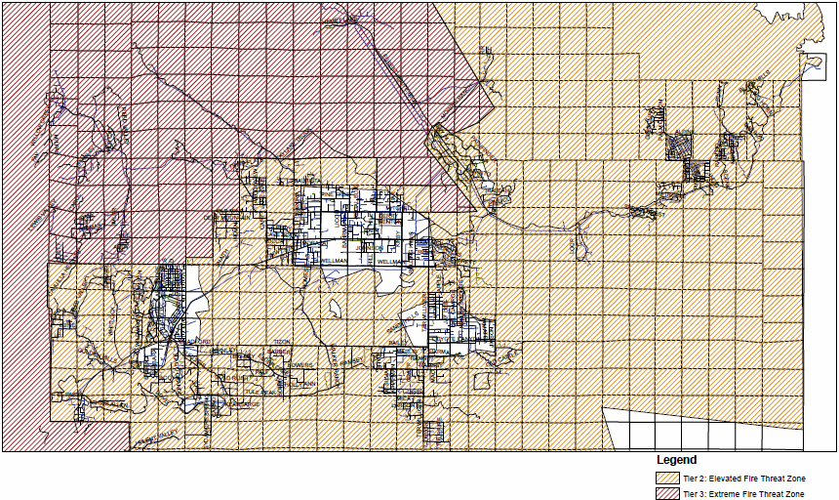
High-Risk Fire Areas in the AEC Service Territory

Slide 12
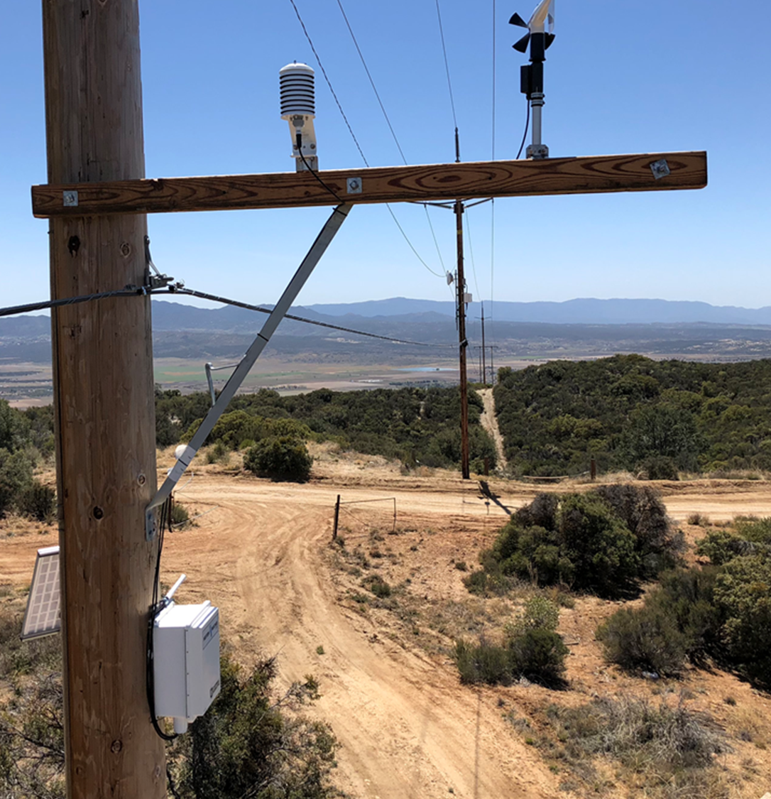
Description of Wildfire Prevention Strategies
AEC Owned Weather Monitoring Stations
5 Strategically Placed In Wind Prone Areas Of AEC’s Service Territory
3 High Resolution 360-degree Cameras That Can Be Controlled Remotely
Researching The Addition Of Fuel Moisture Sensors
Partnerships With SCE And SDG&E To Share Weather Station Information

Slide 13
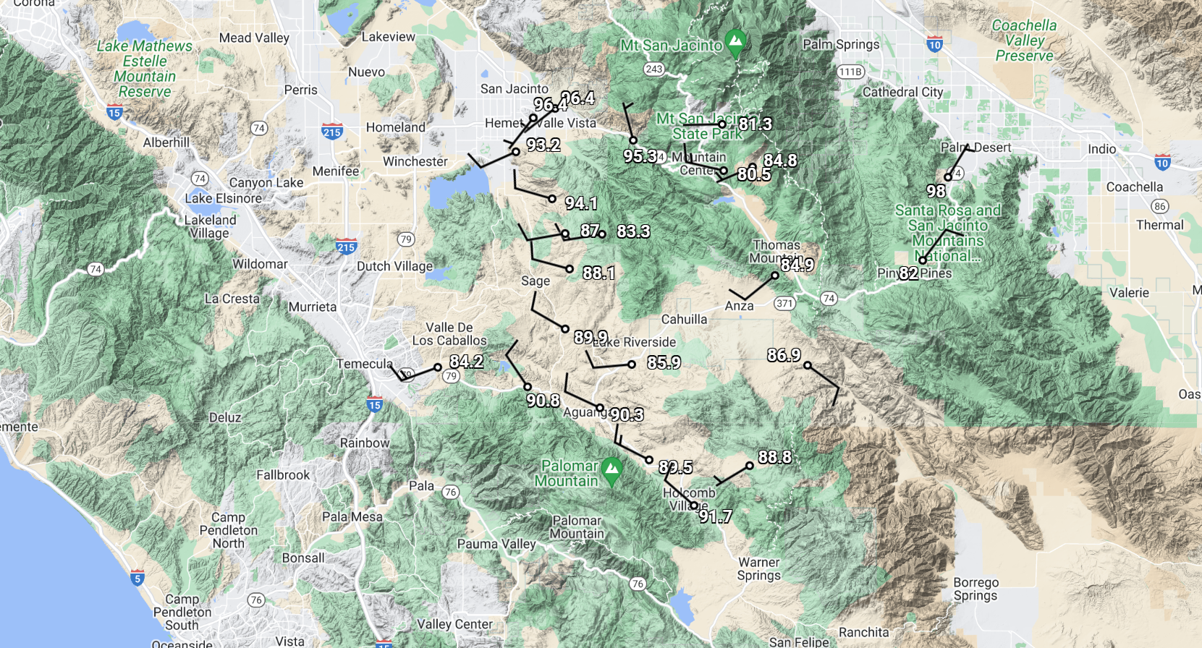
Weather Monitoring Cont.
AEC utilizes weather monitoring systems including:
National Weather Service
AEC has developed four operating conditions based on weather data analysis
Normal Conditions
Elevated Conditions
Extreme Conditions
Red Flag Conditions
Notes:
AEC’s utilizes weather databases that are constantly updated using weather data provided by a number of sources, including the United States National Weather Service (NWS) and AEC’s weather monitoring stations. To date, AEC has installed weather monitoring stations at 5 strategic locations in the high fire threat District 2 and District 3 and will actively deploy more as the need arises. To further improve our situational awareness, AEC is researching adding high visibility, high resolution cameras that will be controlled remotely and can rotate a full 360 degrees.
Normal Condition: This condition is declared when it has been determined that weather conditions are not conducive for wildfires within the AEC service territory;
Fire Danger Level: Low:
When the fire danger is "low" it means that fuels do not ignite easily from small embers, but a more intense heat source, such as lightning, may start fires in duff or dry rotten wood. Fires in open, dry grasslands may burn easily a few hours after a rain, but most wood fires will spread slowly, creeping or smoldering. Control of fires is generally easy.
Elevated Condition: This condition is declared when it has been determined that weather conditions have become conducive for wildfires within the AEC service territory;
Fire Danger Level: Moderate
When the fire danger is "moderate" it means that fires can start from most accidental causes, but the number of fire starts is usually pretty low. If a fire does start in an open, dry grassland, it will burn and spread quickly on windy days. Most wood fires will spread slowly to moderately. Average fire intensity will be moderate except in heavy concentrations of fuel, which may burn hot. Fires are still not likely to become serious and are often easy to control.
Extreme Condition: This condition is declared when it has been determined that a combination of high winds, low relative humidity, and the burn environment will create critical fire weather conditions; and,
Fire Danger Level: High
When the fire danger is "high", fires can start easily from most causes and small fuels (such as grasses and needles) will ignite readily. Unattended campfires and brush fires are likely to escape. Fires will spread easily, with some areas of high intensity burning on slopes or concentrated fuels. Fires can become serious and difficult to control unless they are put out while they are still small.
Red Flag Warning (RFW) Condition: Red Flag Warning Condition is declared by the National Weather Service when high winds and low relative humidity are forecasted to occur for an extended period of time. Depending on the condition reported various operational changes and rules appropriate to each condition will be triggered and implemented.
Fire Danger Level: Very High
When the fire danger is "very high", fires will start easily from most causes. The fires will spread rapidly and have a quick increase in intensity, right after ignition. Small fires can quickly become large fires and exhibit extreme fire intensity, such as long-distance spotting and fire whirls. These fires can be difficult to control and will often become much larger and longer-lasting fires.
Fire Danger Level: Extreme
When the fire danger is "extreme", fires of all types start quickly and burn intensely. All fires are potentially serious and can spread very quickly with intense burning. Small fires become big fires much faster than at the "very high" level. Spot fires are probable, with long-distance spotting likely. These fires are very difficult to fight and may become very dangerous and often last for several days.

Slide 14
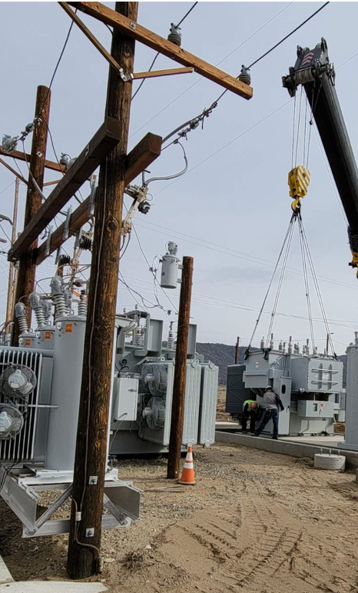
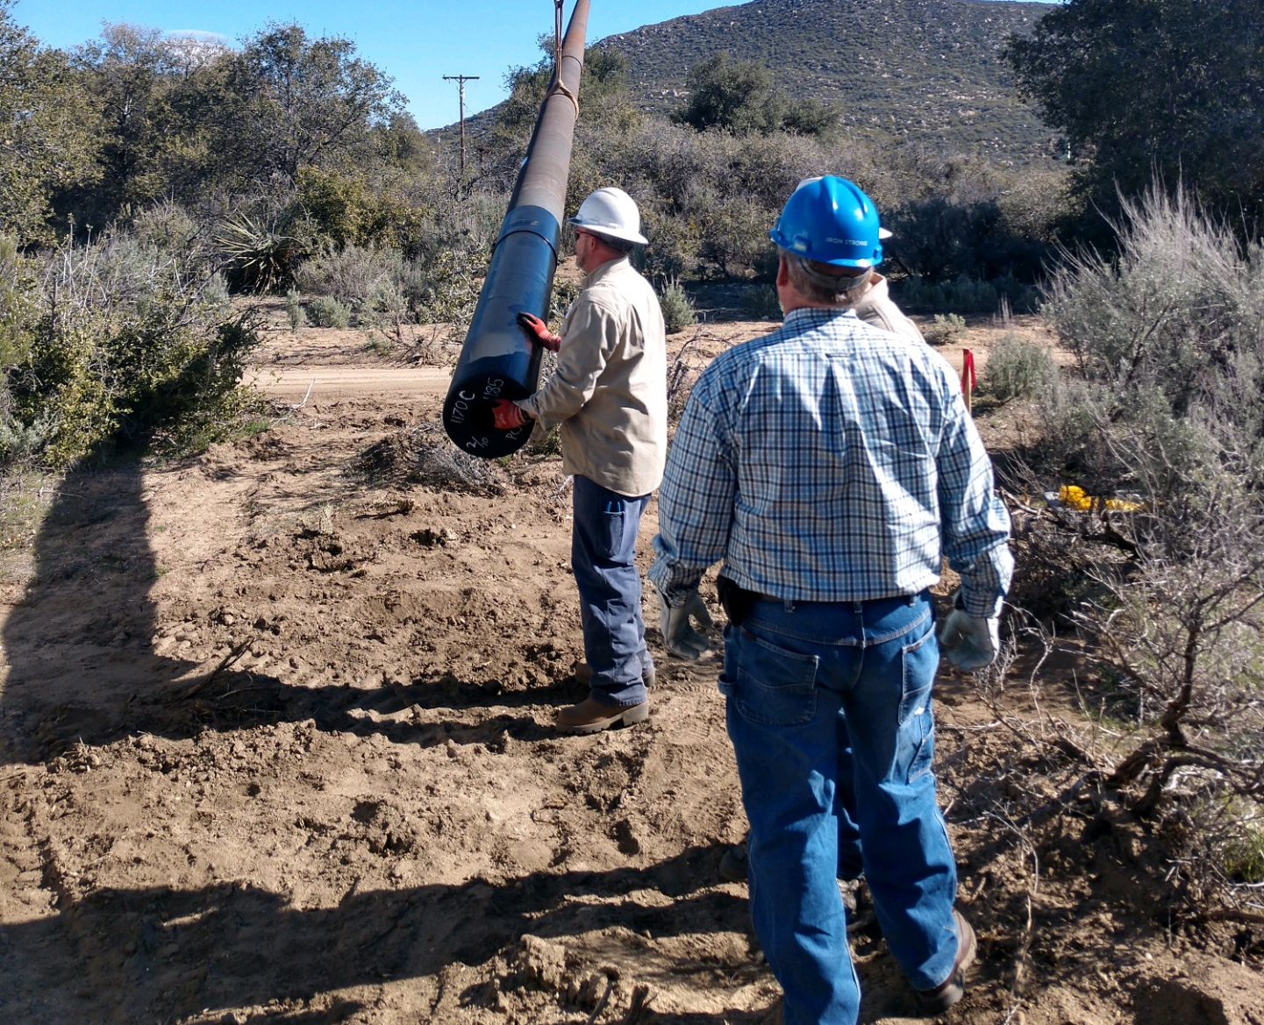
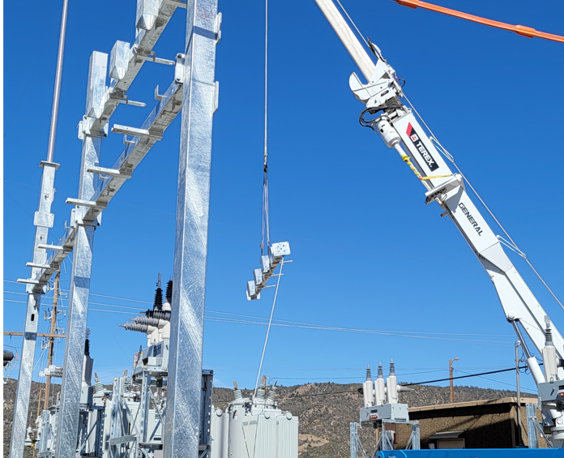
System Resiliency
Design and Construction Standards (Updates)
Rebuild Of Circuit In The Terwilliger Area
Engineering Of Additional Circuits Has Begun
Rebuild Of The Lappos Substation
Wood-to-Ductile Iron Program
As Of Q1 2022 Nearly 200 Wood Poles Replaced
During 2020 3,060 Poles Inspected

Slide 15
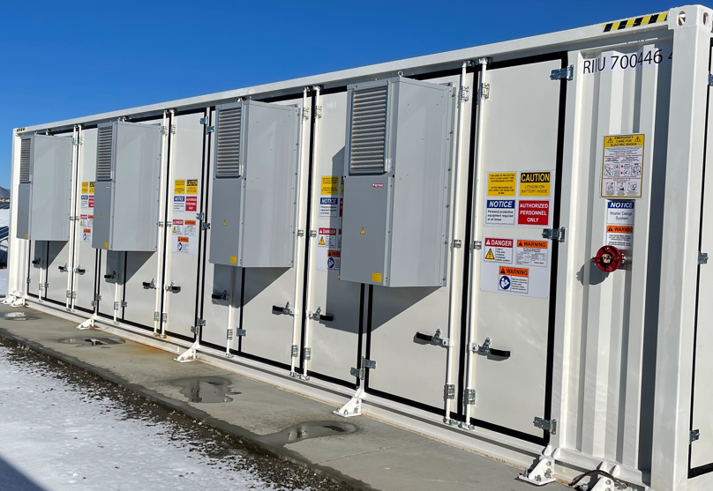
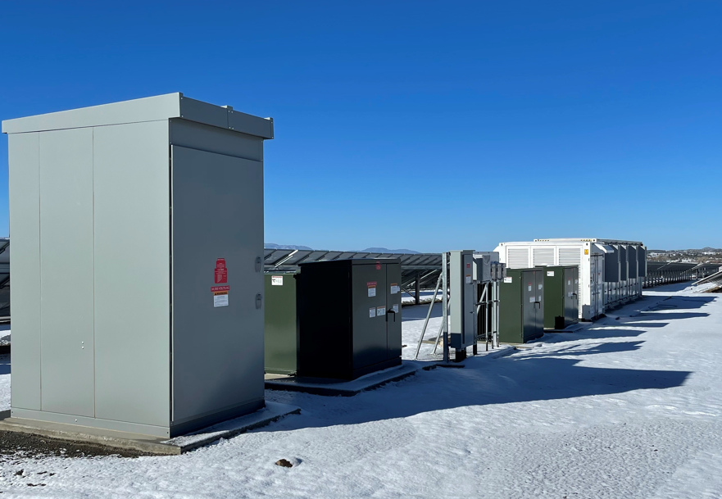
System Resiliency Cont.
Upgrading Automated Reclosers
Include A High Impedance Fault Detection
Phase 2 Of SunAnza & Battery Energy Storage Completed
3.5 MWs Of Solar Combined With 4.5 MWs / 9.5 MWhs Of Battery Storage
Testing and Deploying Emerging Technologies
System High-risk Fuses That Can Be Replaced With Expulsion Fuses
Increased Use Of Wildlife Cover
Increasing The Use Of Conductor Spacers
Outage Mapping In Real-time Is In Progress
Facility Inspection and Repair Program

Slide 16
Vegetation Management
As of December 31, 2020:
A total of 1,792 trees have been either trimmed, removed, cleared around cooperative owned facilities.
In 2021 weed & herbicide treatment applied to 2 substations and our switch station
Developing a Fuels Reduction Program
Updated Ruling by the USFS on February 11, 2022, will be incorporated in future updates

Slide 17
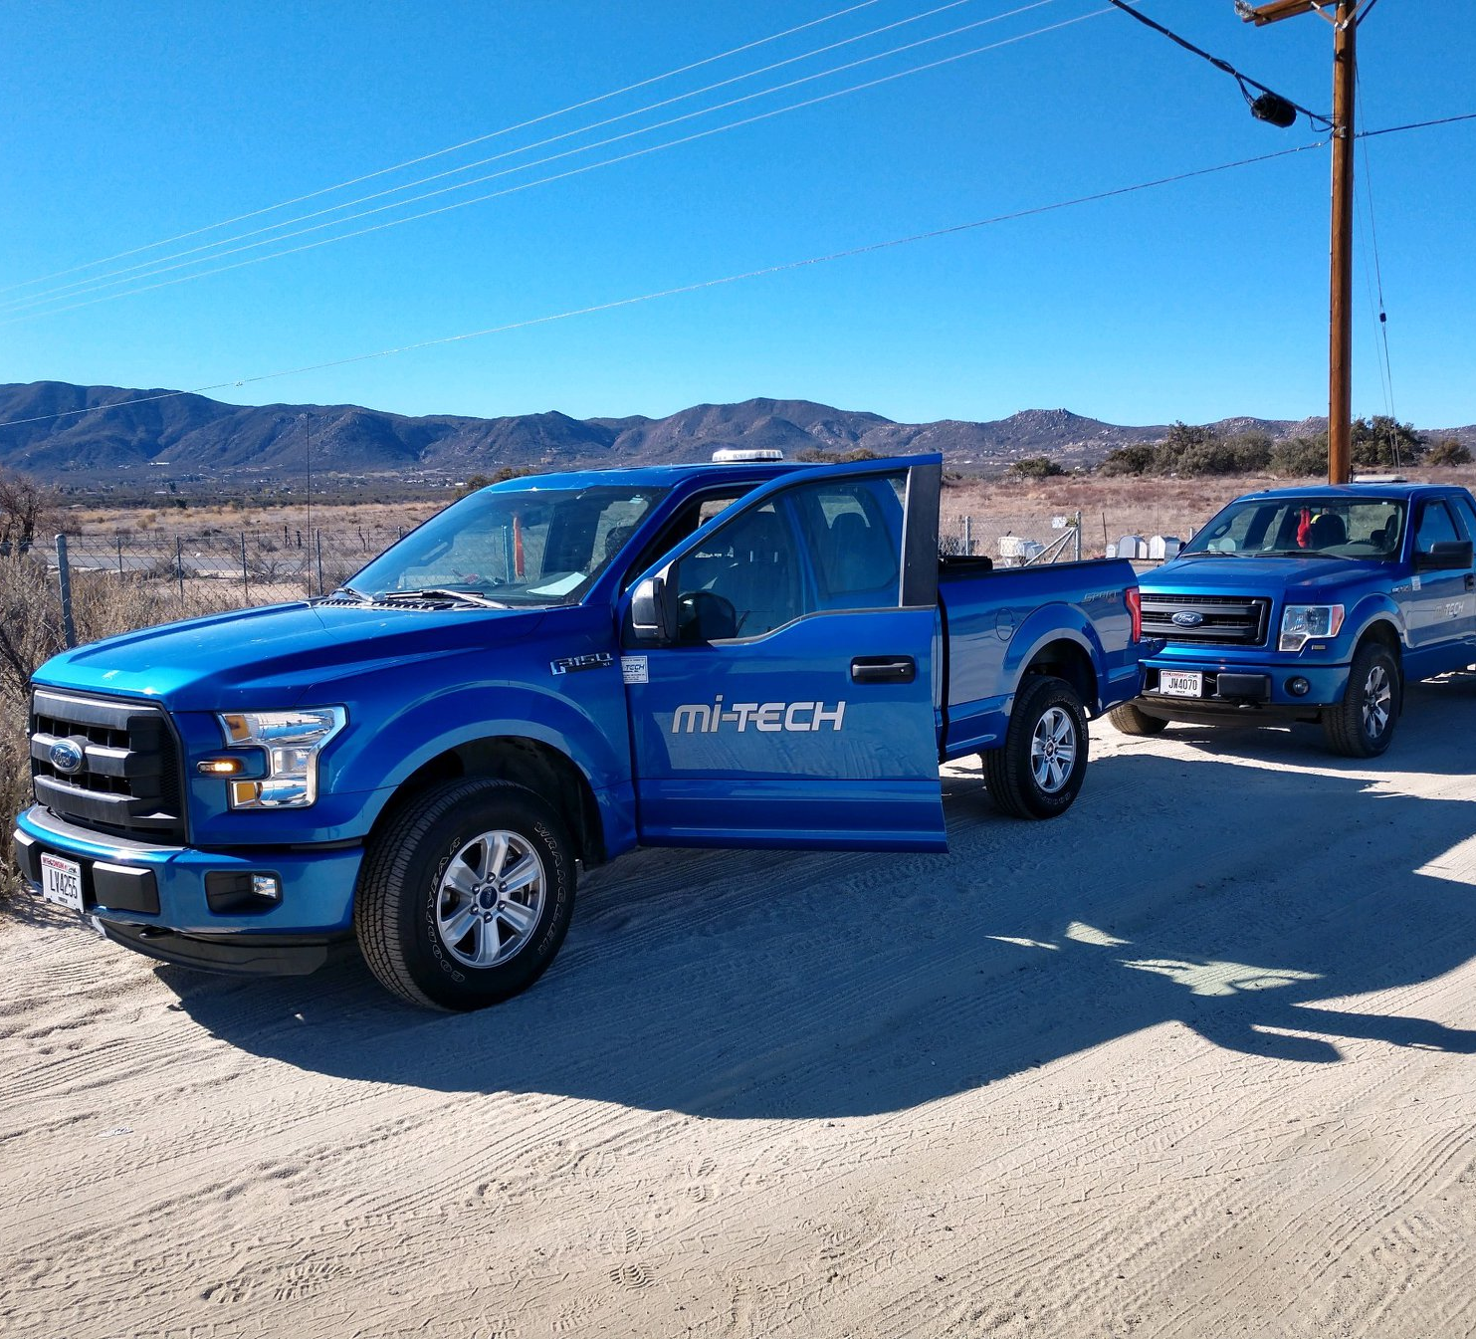
Inspections
Patrol inspections
Detailed
Intrusive
Currently developing real-time outage mapping
Notes:
AEC meets or exceeds the minimum inspection requirements provided in CPUC GO 165 and CPUC GO 95, Rule 18. Pursuant to these rules, AEC inspects electric facilities as follows:
"Patrol inspections" - a simple visual inspection, of applicable utility equipment and structures, that is designed to identify obvious structural problems and hazards. Patrol inspections are be carried out in the course of other AEC business. All poles are visually inspected at minimum, annually.
"Detailed" - one where individual pieces of equipment and structures are carefully examined, visually and through use of routine diagnostic test, as appropriate, and (if practical and if useful information can be so gathered) opened, and the condition of each rated and recorded. Detailed inspections are preformed throughout the system on a rotating cycle every three years. In areas that are in the fire threat District 3 and certain areas of District 2 that are deemed to be of greater fire risk threat, detailed inspections may occur more frequently.
"Intrusive" - involving movement of soil, taking samples for analysis, and/or using more sophisticated diagnostic tools beyond visual inspections or instrument reading are conducted every 5 years. In areas of the system in fire threat District 3 and higher fire risk areas of District 2, intrusive inspections may occur more frequently depending on the age of the facilities.

Slide 18
Workforce Training
AEC believes that an important line of defense against the ignition of fires is a well-trained and alert workforce.
2022 AEC began an internship program for college students enrolled in a forestry management program
All employees are aware of fire threat weather conditions
All employees must immediately:
Report and document any suspicious activities witnessed in the field,
Immediately report and document knowledge of any fires within AEC’s service territory
Document all known information related to any fire within the AEC service territory regardless of the cause.

Slide 19
Community Outreach and Public Awareness
Member education events
Informational and emergency preparedness mailings
Educational advertising campaigns focusing on fire safety awareness
Weather information and system-outage status via AEC social media, website, and member messaging system
Partnerships with the Riverside County Emergency Management Department
Notes:
AEC has created a multi-level approach to community education and outreach as our contribution to public awareness of fire threats, fire prevention and emergency preparedess. The key elements of this approach are described.
Fire Safety Communication
AEC provides regular communications to residents and businesses located within our service territory. These fire-safety and emergency communications include, but are not limited to;

Slide 20
Public Safety Power Shut-off Customer Notification Protocols
AEC plans to begin notifying members approximately 48 hours in advance of a potential PSPS event and will attempt to notify members approximately 24 hours before power is shut off.
Additional notifications will be made throughout the outage. For example, when power has been shut off and when it has been restored.
Notifications may occur via direct phone calls to members on our life support list, member messaging, anzaelectric.org, and social media.
Notes:
There may be situations which prevent AEC from providing advance notice. The actual onset of extreme weather conditions and other circumstances beyond our control may impact coordination and notification efforts.

Slide 21
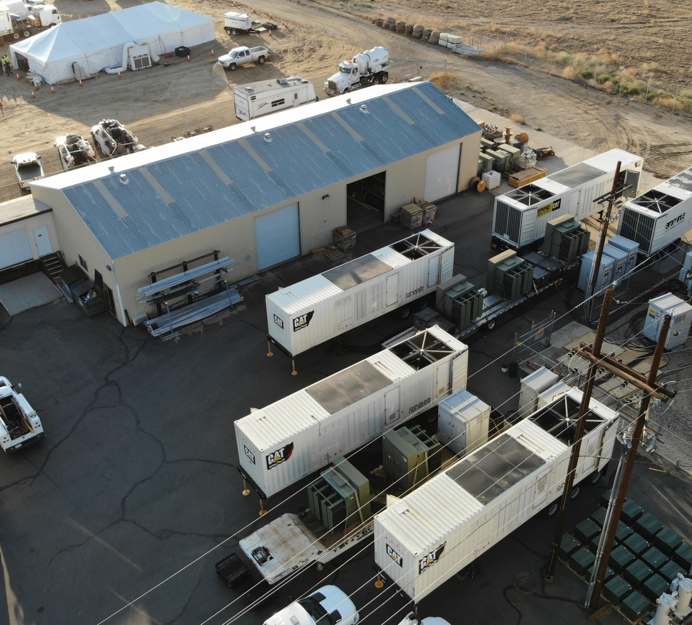
Restoration of Service
Once the extreme fire threat conditions subside and it is safe to do so, AEC crews will begin patrolling power lines, repairing damaged equipment and restoring power to impacted members. AEC will provide condition updates and reasonable notice for the restoration of power.

Slide 22
Evaluating the Plan
Metrics and Assumptions for Measuring Plan Performance:
Compliance Management
Claims, Legal & Regulatory
System Operations, Construction, & Maintenance
Training
Root Cause Analysis
Lessons Learned
Notes:
Metric 1: Fire Ignitions
At the end of emergency events, AEC conducts a debrief and prepares an after-action report that identifies action items to correct or improve future responses. AEC will invoke the actions in its ERP as outlined above.
For purposes of this metric, a fire ignition is defined as follows:
AEC facility was associated with the fire;
The fire was self-propagating and of a material other than electrical and/or communication facilities;
The resulting fire traveled greater than one linear meter from the ignition point; and
AEC has knowledge that the fire occurred.
In future Wildfire Mitigation Plans, AEC will provide the number of fires that occurred that were less than 10 acres in size. Any fires greater than 10 acres will be individually described.
Metric 2: Wires Down
The second metric is the number of distribution and transmission wires downed within AEC’s service territory. For purposes of this metric, a wires down event includes any instance where an electric transmission or primary distribution conductor falls to the ground or on to a foreign object. AEC will divide the wires down metric between wires down inside and outside of the High Fire Threat District.
AEC will not normalize this metric by excluding unusual events, such as severe storms. Instead, AEC will supplement this metric with a qualitative description of any such unusual events

Slide 23
Impact of Metrics on Plan
Primary purpose of these metrics are to provide longer term feedback on the efficacy of AEC’s fire preventative strategies and programs focused on electric facilities.
AEC notes that similar metrics are used for other purposes, e.g., wires down is used in monitoring electric reliability
In other cases, this metric is monitored with "exclusions" in order to normalize unusual events such as extreme weather
For fire purposes, AEC assumes that such metrics should include (rather than exclude) such events and intends to monitor all wires down for fire prevention purposes, rather than only wires down during normal weather.

Slide 24
Independent Evaluation
Public Utilities Code section 8387(c) requires AEC to contract with a qualified independent evaluator with experience in assessing the safe operation of electrical infrastructure to review and assess the comprehensiveness of this Wildfire Mitigation Plan.
In 2020 AEC contracted with Chloeta to conduct an independent evaluation of our Wildfire Mitigation Plan
Report concluded that AEC has developed a comprehensive Wildfire Mitigation Plan

Slide 25
Questions and Comments
AEC would love to hear from you! If you have any burning questions or would like to comment on our plan, please send an email to aec@anzaelectric.org.
Thank You!!

